Slide 1
Lead Score Case Study
Submitted by : Amit Kumar Das Samrat Roy Niladri De

Slide 2
Lead Score Case Study for X Education
Problem Statement :
X Education sells online courses to industry professionals. The company markets its courses on several websites and search engines like Google.
Once these people land on the website, they might browse the courses or fill up a form for the course or watch some videos. When these people fill up a form providing their email address or phone number, they are classified to be a lead. Moreover, the company also gets leads through past referrals.
Once these leads are acquired, employees from the sales team start making calls, writing emails, etc. Through this process, some of the leads get converted while most do not. The typical lead conversion rate at X education is around 30%.
Business Goal:
X Education needs help in selecting the most promising leads, i.e. the leads that are most likely to convert into paying customers.
The company needs a model wherein you a lead score is assigned to each of the leads such that the customers with higher lead score have a higher conversion chance and the customers with lower lead score have a lower conversion chance.
The CEO, in particular, has given a ballpark of the target lead conversion rate to be around 80%.

Slide 3
Strategy
Source the data for analysis
Clean and prepare the data
Exploratory Data Analysis.
Feature Scaling
Splitting the data into Test and Train dataset.
Building a logistic Regression model and calculate Lead Score.
Evaluating the model by using different metrics - Specificity and Sensitivity or Precision and Recall.
Applying the best model in Test data based on the Sensitivity and Specificity Metrics.

Slide 4
Problem solving methodology
Data Sourcing , Cleaning and Preparation
Read the Data from Source
Convert data into clean format suitable for analysis
Remove duplicate data
Outlier Treatment
Exploratory Data Analysis
Feature Standardization.
Feature Scaling and Splitting Train and Test Sets
Feature Scaling of Numeric data
Splitting data into train and test set.
Model Building
Feature Selection using RFE
Determine the optimal model using Logistic Regression
Calculate various metrics like
accuracy, sensitivity, specificity, precision and recall and evaluate the model.
Result
Determine the lead score and check if target final predictions amounts to 80% conversion rate.
Evaluate the final prediction on the test set using cut off threshold from sensitivity and specificity metrics

Slide 5
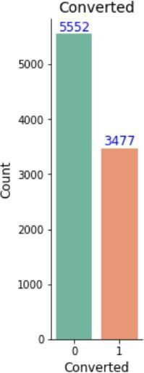
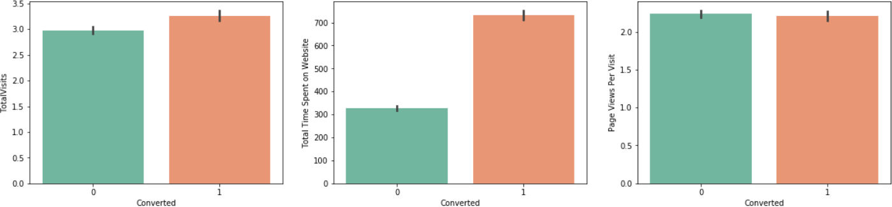
Exploratory Data Analysis
We have around 39% Conversion rate in Total
The conversion rates were high for Total Visits, Total Time Spent on Website and Page Views Per Visit
.

Slide 6
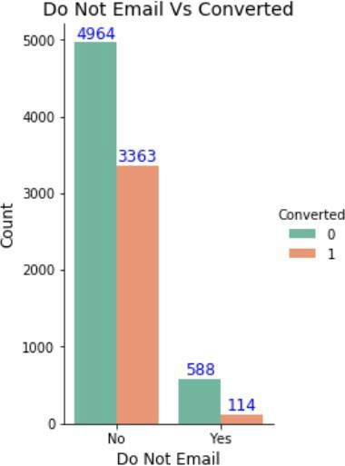
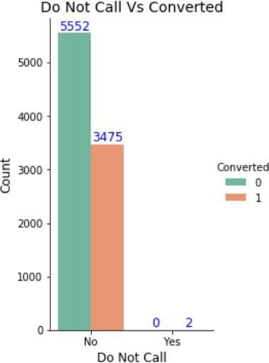
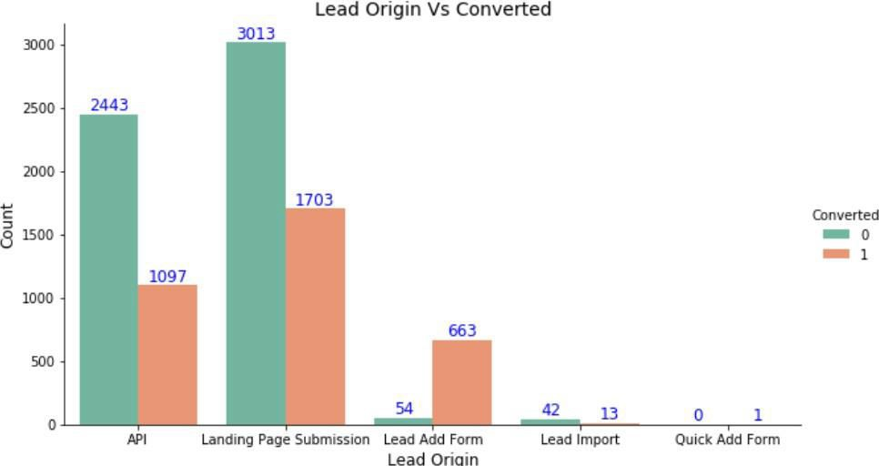
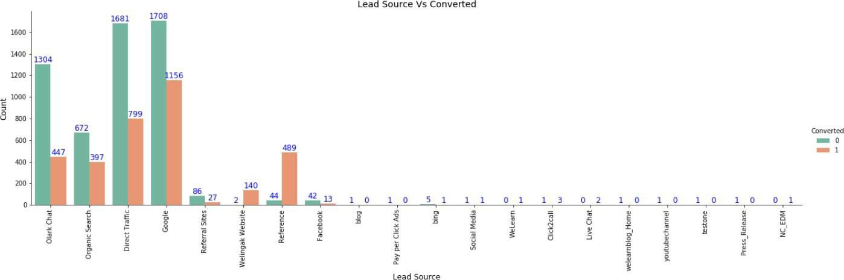
In Lead Origin, maximum conversion happened from Landing Page Submission
Major conversion has happened from Emails sent and Calls made
Major conversion in the lead source is from Google

Slide 7
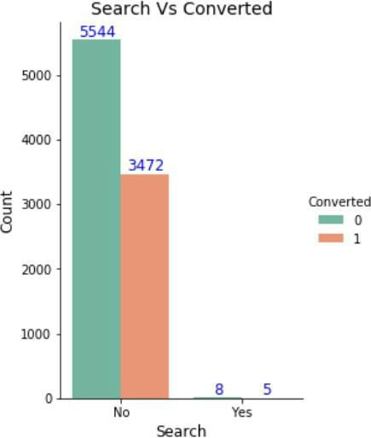
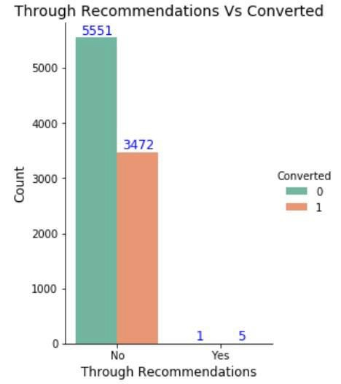
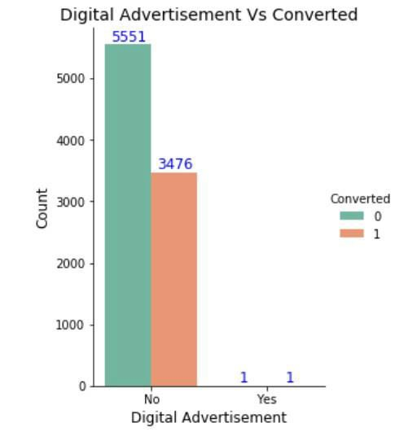
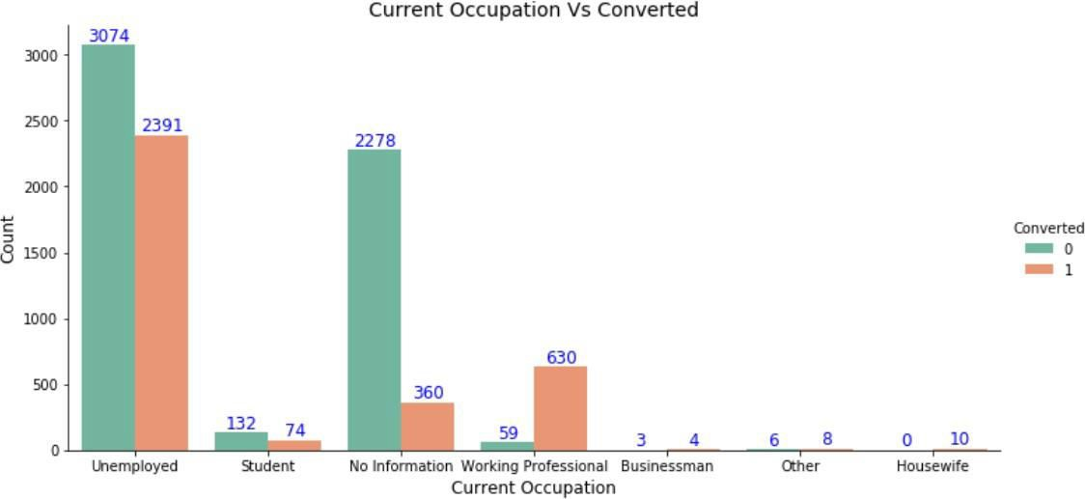
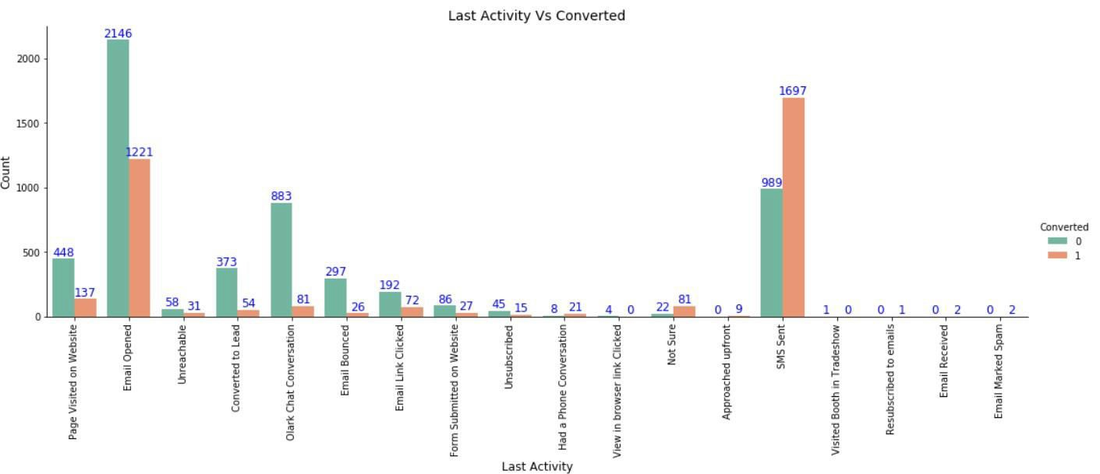
Not much impact on conversion rates through Search, digital advertisements and through recommendations
More conversion happened with people who are unemployed
Last Activity value of SMS Sent' had more conversion.

Slide 8
Variables Impacting the Conversion Rate
Do Not Email
Total Visits
Total Time Spent On Website
Lead Origin – Lead Page Submission
Lead Origin – Lead Add Form
Lead Source - Olark Chat
Last Source – Welingak Website
Last Activity – Email Bounced
Last Activity – Not Sure
Last Activity – Olark Chat Conversation
Last Activity – SMS Sent
Current Occupation – No Information
Current Occupation – Working Professional
Last Notable Activity – Had a Phone Conversation
Last Notable Activity - Unreachable

Slide 9
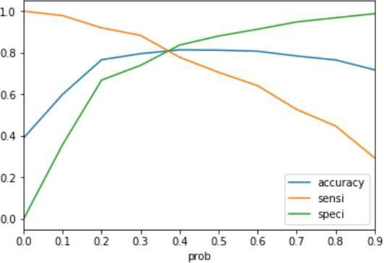
Model Evaluation - Sensitivity and Specificity on Train Data Set
The graph depicts an optimal cut off of 0.37 based on Accuracy, Sensitivity and Specificity
Confusion Matrix
3161 697
974 1965
Accuracy - 81%
Sensitivity - 80 %
Specificity - 82 %
False Positive Rate - 18 %
Positive Predictive Value - 74 %
Positive Predictive Value – 86%

Slide 10
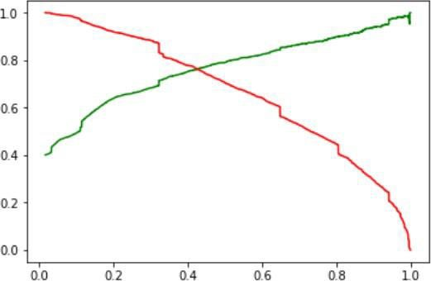
Model Evaluation- Precision and Recall on Train Dataset
The graph depicts an optimal cut off of 0.42 based on Precision and Recall
Confusion Matrix
3397 461
725 1737
Precision - 79 %
Recall - 71 %

Slide 11
Model Evaluation – Sensitivity and Specificity on Test Dataset
Confusion Matrix
1394 300
218
797
Accuracy - 81 %
Sensitivity - 79 %
Specificity - 82 %

Slide 12
Conclusion
While we have checked both Sensitivity-Specificity as well as Precision and Recall Metrics, we have considered the optimal cut off based on Sensitivity and Specificity for calculating the final prediction. –
Accuracy, Sensitivity and Specificity values of test set are around 81%, 79% and 82% which are approximately closer to the respective values calculated using trained set.
Also the lead score calculated shows the conversion rate on the final predicted model is around 80% (in train set) and 79% in test set
The top 3 variables that contribute for lead getting converted in the model are
  Total time spent on website
  Lead Add Form from Lead Origin
  Had a Phone Conversation from Last Notable Activity
Hence overall this model seems to be good.

